Slide 1
What You Need to Know About Financial Aid

Slide 2
Topics We Will Discuss Tonight
What is financial aid
Cost of attendance (COA)
Expected Family Contribution (EFC)
What is financial need
Categories, types, and sources of financial aid
Free Application for Federal Student Aid (FAFSA)
Special circumstances

Slide 3
What is Financial Aid?
Financial aid consists of funds provided to students and families to help pay for postsecondary educational expenses

Slide 4
What is Cost of Attendance (COA)
Direct costs
Indirect costs
Direct and indirect costs combined into cost of attendance
Varies widely from college to college

Slide 5
What is the Expected Family Contribution (EFC)
Amount family can reasonably be expected to contribute
Stays the same regardless of college
Two components
Parent contribution
Student contribution
Calculated using data from a federal application form and a federal formula

Slide 6
What is Financial Need
Cost of Attendance
– Expected Family Contribution
= Financial Need

Slide 7
Categories of Financial Aid
Need-based
Non-need-based

Slide 8
Types of Financial Aid
Scholarships
Grants
Loans
Employment
Gift Aid
Self-Help Options

Slide 9
Gift Aid: Scholarships
Money that does not have to be paid back
Awarded on the basis of merit, skill, or unique characteristic

Slide 10
Gift Aid: Grants
Money that does not have to be paid back
Usually awarded on the basis of financial need

Slide 11
Self-Help Option: Loans
Money students and parents borrow to help pay college expenses
Repayment usually begins after education is finished
Only borrow what is really needed
Look at loans as an investment in the future

Slide 12
Self-Help Option: Employment
Allows student to earn money to help pay educational costs
A paycheck; or
Non-monetary compensation, such as room and board

Slide 13
Sources of Financial Aid
Federal government
States
Private sources
Civic organizations and churches
Employers

Slide 14
Federal Government
Largest source of financial aid
Aid awarded primarily on the basis of financial need
Must apply each year using the Free Application for Federal Student Aid (FAFSA)

Slide 15
Common Federal Aid Programs
Federal Pell Grant
Teacher Education Assistance for College and Higher Education Grant
Federal Supplemental Educational Opportunity Grant
Federal Perkins Loan
Federal Work-Study
Subsidized and Unsubsidized Loans
PLUS Loans

Slide 16
States
Residency requirements 12/31/2017
Award aid on the basis of both merit and need
Use information from the FAFSA
Deadlines vary by state- Indiana March 10, 2017 – Received by Date

Slide 17
Private Sources
Foundations, businesses, charitable organizations
Deadlines and application procedures vary widely
Begin researching private aid sources early

Slide 18
Civic Organizations and Churches
Research what is available in community
To what organizations and churches do student and family belong?
Application process usually spring of senior year
Small scholarships add up!

Slide 19
Employers
Companies may have scholarships available to the children of employees
Companies may have educational benefits for their employees

Slide 20
Free Application for Federal Student Aid (FAFSA)
A standard form that collects demographic and financial information about the student and family
Must be filed electronically
Available in English and Spanish

Slide 21
FAFSA
Information used to calculate the Expected Family Contribution or EFC
The amount of money a student and his or her family may reasonably be expected to contribute towards the cost of the student’s education for an academic year
Colleges use EFC to award financial aid

Slide 22
FAFSA
May be filed at any time during an academic year, but no earlier than the October1st prior to the academic year for which the student requests aid
For the 2018-19 academic year, the FAFSA may be filed beginning October 1, 2017
Colleges may set FAFSA filing deadlines

Slide 23
FAFSA
Website: www.fafsa.gov
2018-19 FAFSA available on October 1, 2017

Slide 24
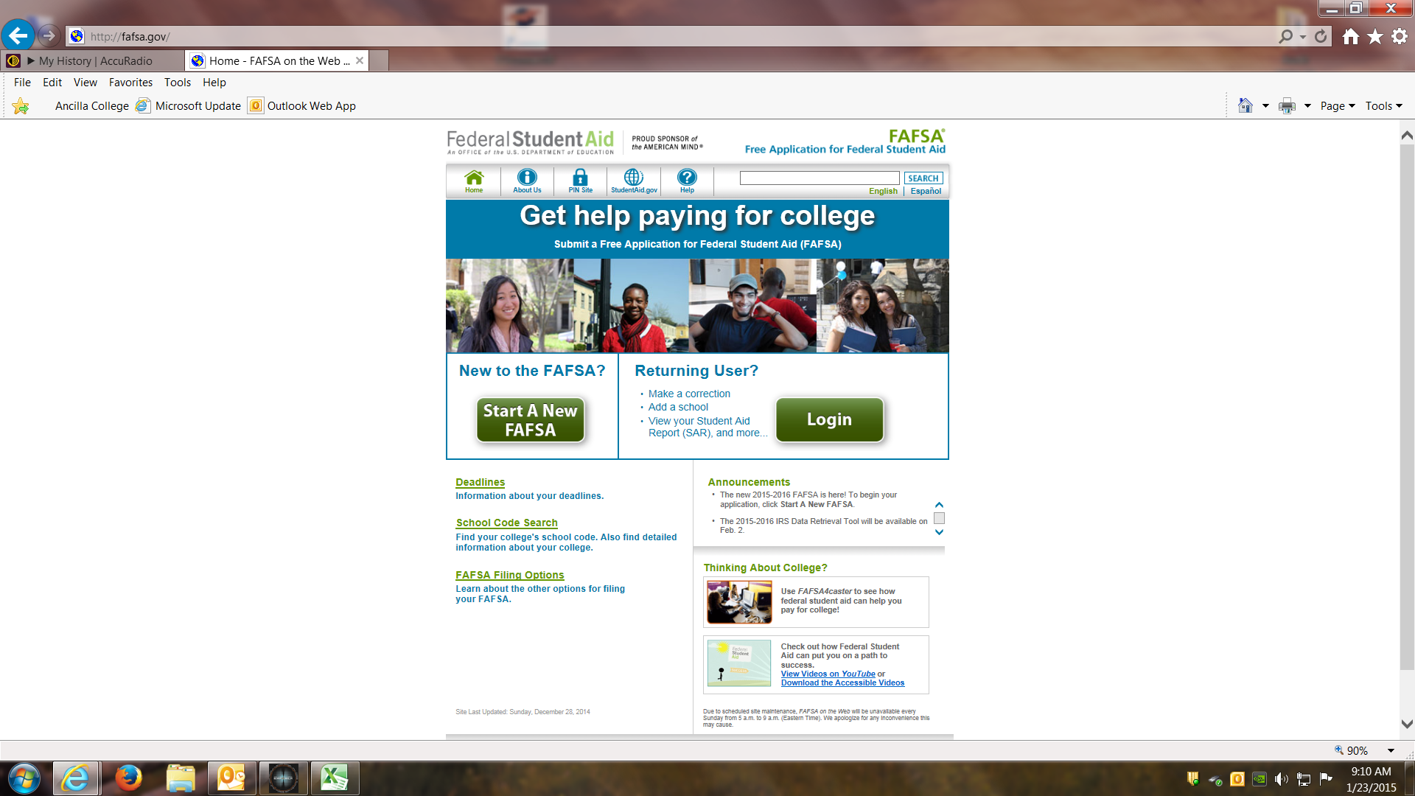

Slide 25
FAFSA
Benefits to filing electronically:
Built-in edits to prevent costly errors
Skip logic allows student and/or parent to skip unnecessary questions
Option to use Internal Revenue Service (IRS) Data Retrieval Tool

Slide 26
FAFSA
Benefits to filing electronically:
More detailed instructions and “help” for common questions
Ability to check application status online
Simplified application process

Slide 27
IRS Data Retrieval Tool
While completing FAFSA, applicant may submit real-time request to IRS for tax data
IRS will authenticate taxpayer’s identity
If match found, IRS sends real-time results to applicant in new window
Applicant chooses whether or not to transfer data to FAFSA

Slide 28
IRS Data Retrieval Tool
Participation is voluntary-Strongly encouraged
Reduces documents requested by financial aid office

Slide 29
IRS Data Retrieval Tool
Some will be unable to use IRS DRT
Examples include:
No SSN was entered
Student or parent married but filed separately

Slide 30
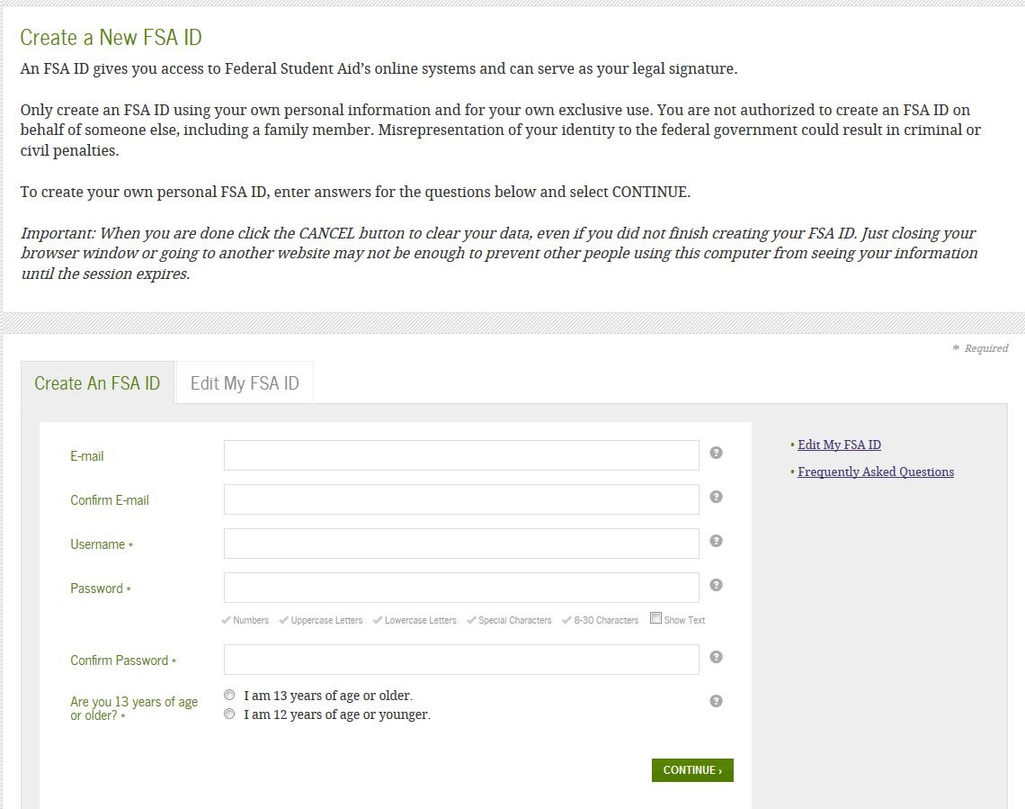
Federal Student Aid Personal Identification Username and Password (FSA ID)
Website: www.fsaid.ed.gov
Sign FAFSA electronically
Student and parent are both required to have separate FSA ID’s.
Use separate personal emails to create

Slide 31
General Student Information
Social Security Number
Citizenship status
Selective Service registration
High School Completion

Slide 32
Student Dependency Status
FAFSA asks questions to determine status:
If all “No” responses, student is dependent
If “Yes” to any question, student is independent

Slide 33
Information About the Parents of Dependent Students
Tax, income, and other financial information
Dislocated worker status
Assets

Slide 34
Information About the Student (and Spouse)
Tax, income, and other financial information
Dislocated worker status
Assets

Slide 35
Additional Information
College and housing information

Slide 36
Signatures
Required
Student
One parent (dependent students)
Format
Electronic using FSA ID

Slide 37
Frequent FAFSA Errors
Social Security Numbers
Divorced/remarried parental information
Income earned by parents/stepparents
Untaxed income
U.S. income taxes paid
Household size
Number of household members in college
Real estate and investment net worth

Slide 38
FAFSA Processing Results
CPS notifies student of FAFSA processing results by:
E-mail
Review data for accuracy
Student with FSA ID may view SAR on-line at www.fafsa.gov

Slide 39
FAFSA Processing Results
Institutional Student Information Record (ISIR) sent to colleges listed on FAFSA approximately 10 to 14 days after FAFSA submitted
College reviews ISIR
May request additional documentation, such as proof that a sibling is enrolled in college

Slide 40
Making Corrections
If necessary, corrections to FAFSA data may be made by:
Accessing FAFSA at www.fafsa.gov
Submitting documentation to college’s financial aid office

Slide 41
Special Circumstances
Cannot report on FAFSA
Send written explanation to financial aid office at each college

Slide 42
Special Circumstances
Change in employment status
Medical/Dental expenses not covered by insurance
Change in parent marital status
Unusual dependent care expenses

Slide 43
Questions?

